Slide 1


Predicting energy consumption at an hourly frequency for San Diego Gas & Electric (SDGE) utility region

Slide 2
Problem statement
Electricity cannot be stored in large amounts, so supply and demand should always be matched.
Load/energy demand forecasting is fundamental for an energy utility’s decision making mechanism to avoid:
- Grid failures or Wastage of energy
- Costs of under or over cutting
Notes:
- The energy companies need to know how much energy to produce at any given time to avoid grid failures or wastage of energy.
- Costs of under- or over-cutting are high in an energy balancing market which can lead to huge financial losses for an utility.
- They cannot pass their cost to the customers.

Slide 3
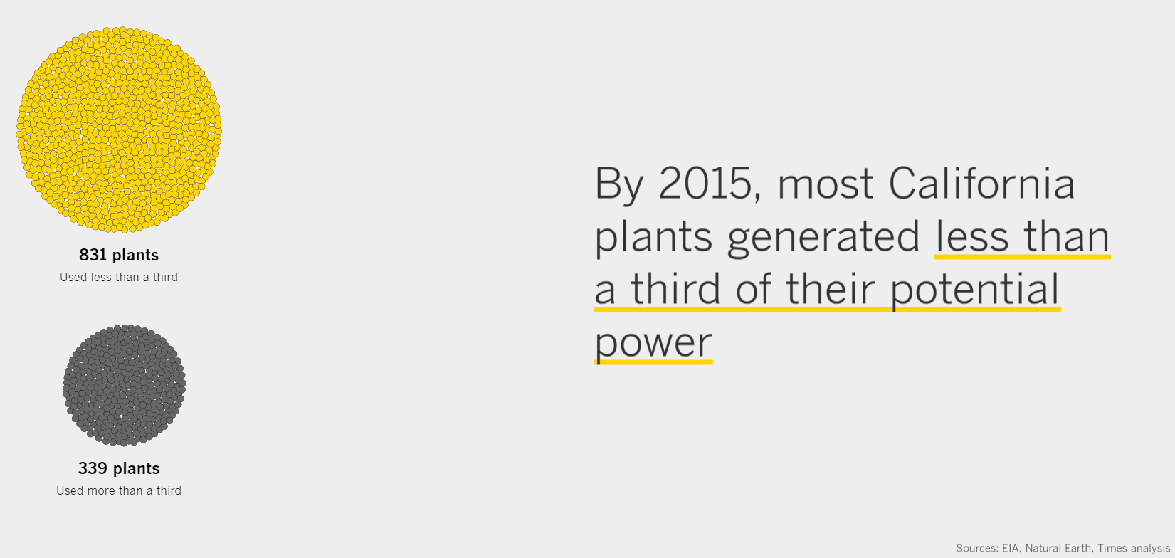
https://www.latimes.com/projects/la-fi-electricity-capacity-graphic/
Notes:
https://www.latimes.com/projects/la-fi-electricity-capacity-graphic/

Slide 4
Goal
Electrical utilities can use the forecast to :
Effectively plan their energy generation operations and balance the demand with appropriate supply.
Meet their customers’ energy demand, and avoid excess generation of energy.

Slide 5
Load forecasting
Load -> Demand (in W) or Energy (in Wh)
For hourly data they are the same
The peak or maximum load decides the capacity of power plant

Slide 6
Process flowchart
Importing data
Hourly energy data
Sub-hourly weather data
PV installation data
Data /cleaning/wrangling
Data /cleaning/wrangling/resampling
Data /cleaning/wrangling/resampling
Extracting features
Extracting features
Adding features
Merge
EDA
Preparing data for ML models, Feature engineering, define error metrics
ML models training & testing and comparing results

Slide 7
DATA

Slide 8
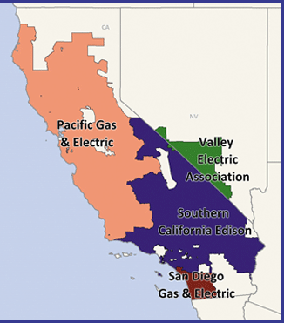
Energy Data
California Independent System Operator (CAISO)
- Data link1, link2
We’ll focus on SDGE (San Diego Gas and Electric) utility for this project.
Small area serves better chance to use uniform weather data.
San Diego has high enough population and good distribution of residential and commercial customers.

Slide 9
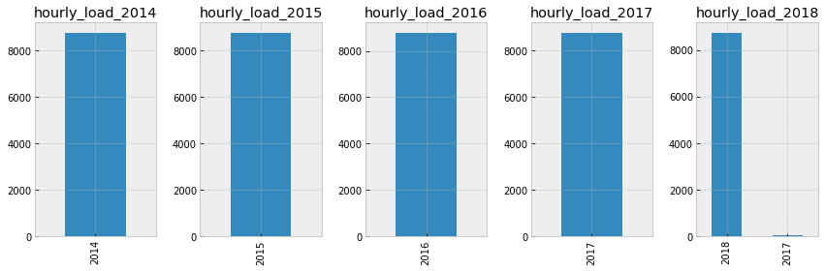
Energy Data Cleaning
Data imported directly from URLs and stored in pandas dataframes.
Data cleaning and formatting done with the help of data visualization (see below) and Descriptive stats.
The null values were filled with the average values of the matching year, month and weekday for the same hours from the rest of the data.

Slide 10
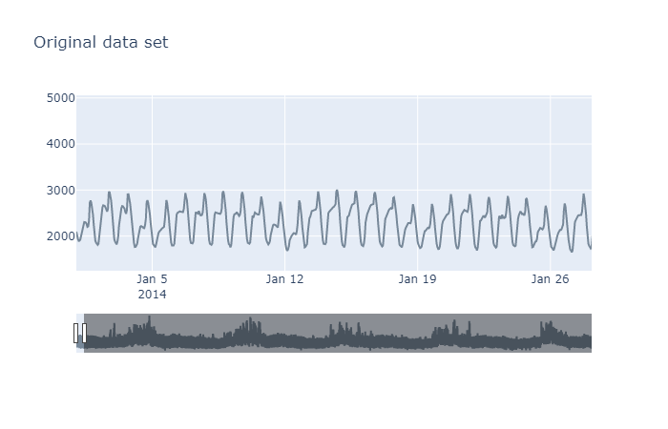
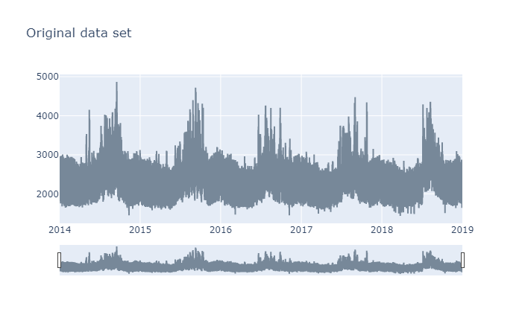
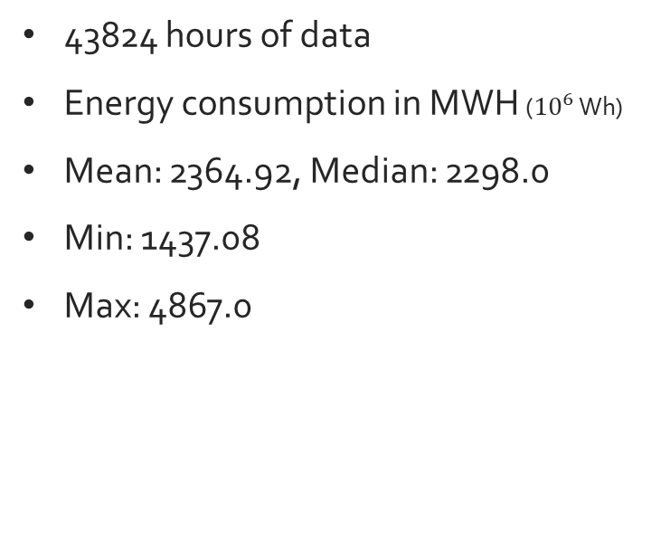
SDGE Energy time series
43824 hours of data
Energy consumption in MWH (${10}^{6}$ Wh)
Mean: 2364.92, Median: 2298.0
Min: 1437.08
Max: 4867.0

Slide 11
Extracting time related features
 | Dates | SDGE | Date | year | month | day | hour | weekday | season | holiday | non_working
0 | 2014-01-01 00:00:00 | 2096.0 | 2014-01-01 | 2014 | 1 | 1 | 0 | Wednesday | winter | 1 | non-working
1 | 2014-01-01 01:00:00 | 1986.0 | 2014-01-01 | 2014 | 1 | 1 | 1 | Wednesday | winter | 1 | non-working
2 | 2014-01-01 02:00:00 | 1936.0 | 2014-01-01 | 2014 | 1 | 1 | 2 | Wednesday | winter | 1 | non-working
3 | 2014-01-01 03:00:00 | 1896.0 | 2014-01-01 | 2014 | 1 | 1 | 3 | Wednesday | winter | 1 | non-working
4 | 2014-01-01 04:00:00 | 1899.0 | 2014-01-01 | 2014 | 1 | 1 | 4 | Wednesday | winter | 1 | non-working
SDGE -> Hourly energy consumption data in MWH
Holiday -> national holidays as per US calendar
Non-working -> Holiday + Weekend

Slide 12
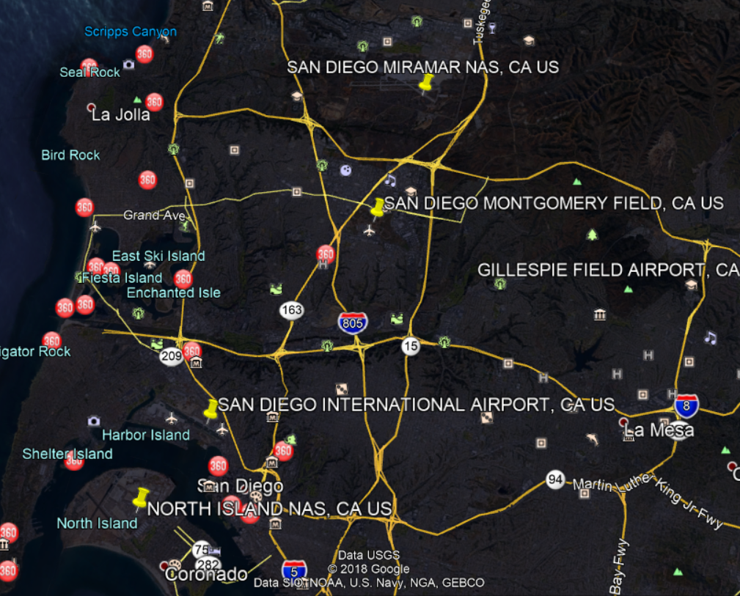
Weather Data
Weather impacts energy consumption, specifically the temperature. Importing 7 minute interval weather data from NOAA’s site.
Yellow pins-> weather stations in San Diego region
For this project choosing the airport data:
More accurate
Not biased by nearby buildings and industries
Notes:
we can always add in data from more stations and use them to see if it helps in the forecast

Slide 13
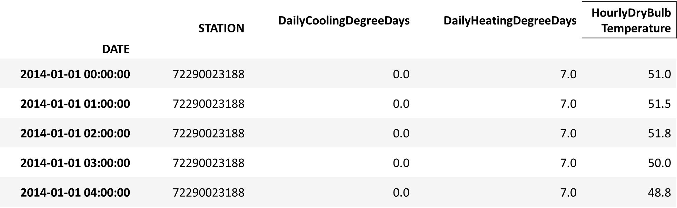
Cleaning and Resampling weather data
Resampling the weather data in hourly intervals and calculating average temperature for each hour.
We'll focus on using only the temperature data but cleaning other columns nonetheless for future purposes.
'STATION’ -> the weather station id
'DATE’ -> the date and time of recording.
'HourlyDryBulbTemperature’ -> the outside temperature in ℉.
Degree days: number of degrees by which the average daily temperature is > 65°F ('DailyCoolingDegreeDays') or < 65°F ('DailyHeatingDegreeDays').
Notes:
Only a few columns from the weather data were imported and used for this project.
'STATION’ -> the weather station id at which the data was recorded. Since we are using airport data we will have only station id.
'DATE’ -> the date and time of recording.
'HourlyDryBulbTemperature’ -> the outside temperature in ℉.
Degree days are defined as the number of degrees by which the average daily temperature is higher than 65°F ('DailyCoolingDegreeDays') or lower than 65°F ('DailyHeatingDegreeDays'). Degree days reflect changes in climate and are used as a proxy for the energy demand for heating or cooling buildings.
Initially we'll focus on using only the temperature data but cleaning other columns nonetheless for future purposes.

Slide 14
EDA

Slide 15
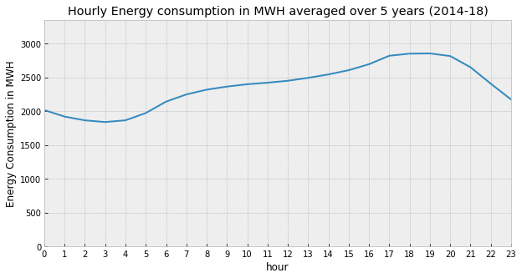
Hourly energy consumption
The load remains low over the night and then starts increasing in the late morning, and continues increasing during the office hours and peaks in the evening when everyone returns home and turns on the electrical appliances.

Slide 16
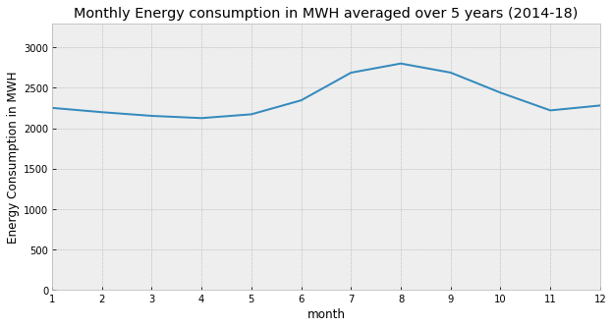
Monthly load profile
Peaks in the summer due to high cooling (air-conditioning) loads caused by high temperatures.

Slide 17

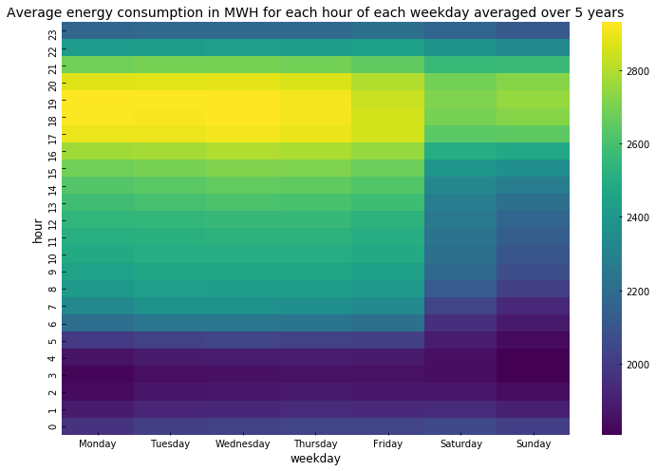
Hourly vs Weekdays
From SDGE's website: "If customers can shift some of their energy use to lower-cost time periods outside 4 p.m. to 9 p.m., they can lower their electricity bills and make better use of cleaner, renewable energy sources, like wind and solar, when they are more available."
Notes:
It can be seen that the average consumption from Monday to Friday is below 2000 in the night and it increases during the day and is at peak (>2800) during the evening time before sliding down again for the night.
And on the weekends the same pattern can be observed but the overall consumption seems lower on weekends than weekdays as expected because most of the commercial buildings don't operate on weekends (also maybe because people go out on weekends and are not usually at home?)
SDG&E began transitioning residential customers to Time-of-Use (TOU) pricing plans in early 2019; a TOU plan is one wherein the utility applies different rates to the customers for different time slots during the day. And in fact, SDGE applies highest rate (peak rate) during 4pm to 9pm to its customers as compared to other hours during the day. From SDGE's website: "If customers can shift some of their energy use to lower-cost time periods outside 4 p.m. to 9 p.m., they can lower their electricity bills and make better use of cleaner, renewable energy sources, like wind and solar, when they are more available."

Slide 18
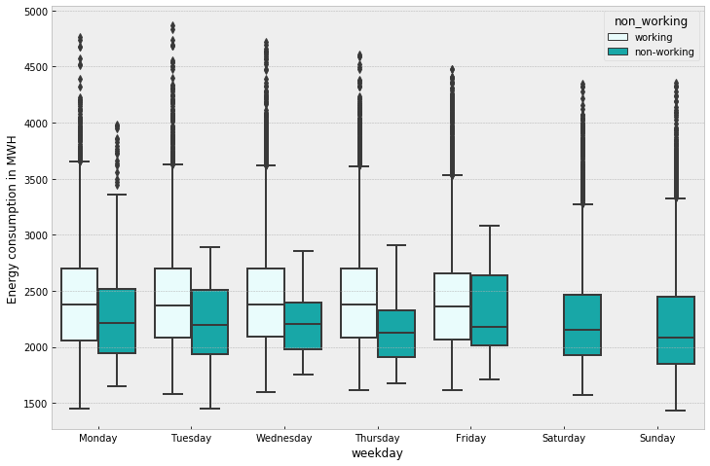
Energy distribution Working vs Non-Working
Notes:
It can be seen that the median energy consumption on working days remains fairly same from Monday to Friday and drops on the weekend as seen before in the heatmap.
Also, if a particular day is a holiday or non-working day (indicated in dark green) the energy consumption is much lower than if the same day was a working day as expected.

Slide 19
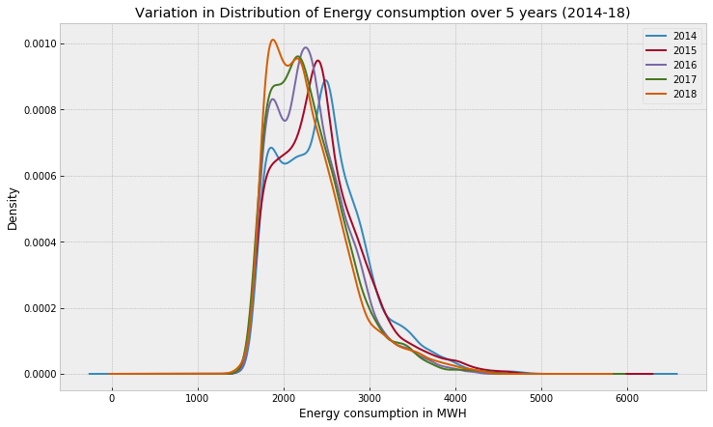
Distribution of energy consumption over different years
Bi-modal. Peak shifts towards left from 2014-18.
Potential reasons:
increasing renewable energy installations at customer sites (called as behind the meter)
Increase in electric efficiency standards of appliances or industry equipment
Battery installations at customer sites

Slide 20
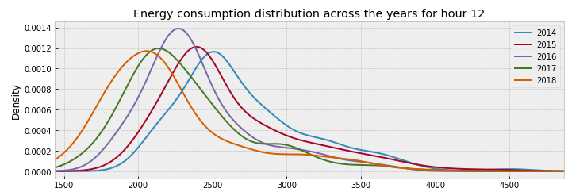
Distribution plots hourly
Left shift is more dominant during the daylight hours of 8am to 5pm.
Addition of more renewables like solar and wind behind the customer meters.
Notes:
If we plot the above distribution plot for each hour (see an example plot below) we can see that the distribution for each hour has shifted towards lower energy consumption values from 2014 to 2018, and this effect is more dominant during the daylight hours of 8am to 5pm.
One of the reasons for this shift during daylight hours can be the addition of more renewables like solar and wind behind the customer meters. We will see later that the solar installations in the SDGE have increased considerably over the last 5 years.

Slide 21

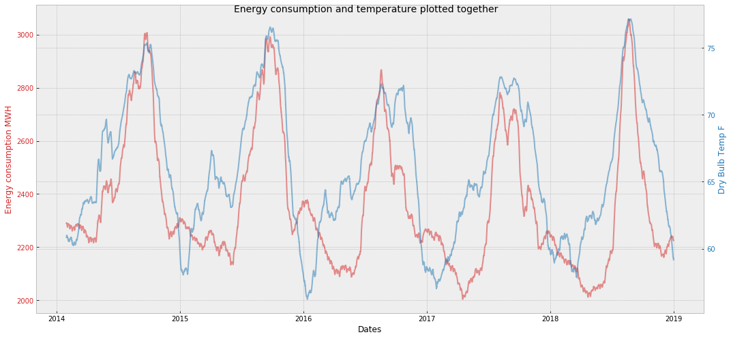
Exploring energy and weather data together
* Rolling monthly mean average of both variables
Notes:
As suspected before, we can see that the energy consumption and temperature do kind of follow each other and seem to have some level of correlation between them.
More importantly we can see that the highest energy consumption values (peak demand) occur at highest temperatures. This, as mentioned before, is the reason of higher cooling loads at higher temperatures.

Slide 22
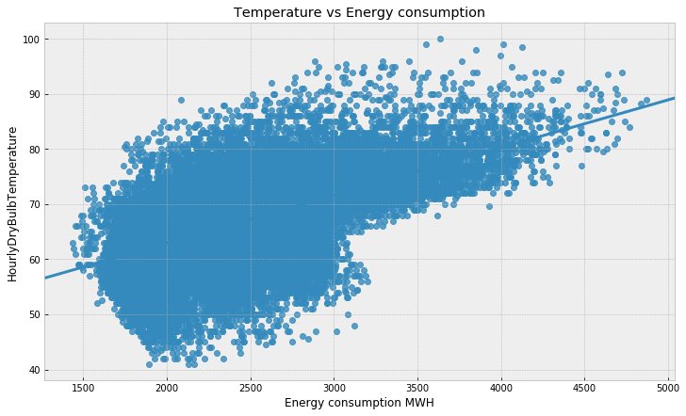
Energy consumption vs Temperature
Observed Pearson correlation coefficient between temperature and energy -
for winter 0.32.
for summer 0.65.

Slide 23
EDA inspired data

Slide 24
Photovoltaic (PV) installation data
After some initial EDA it was observed that:
The energy consumption & peak demand have decreased from 2014-18.
The decrease is more dominant over the daylight hours, so we can test the theory that maybe solar panel capacity installed in the utility region has increased over the years and thus more and more customers are using less energy when the sun is out.
We can test this theory by importing the solar installations data in SDGE territory.
Notes:
This can be due to stricter energy efficiency measures being mandated, or increase of incentives for different categories of ratepayers to install self-generation resources like solar, wind, etc. and/or energy storage in their premises to avoid peak loads and decrease overall energy consumption.

Slide 25
PV data
The solar installations data was imported from CA.gov here -> 'NEM Currently Interconnected Data Set’.
Many columns but we’ll focus on:
'approval date’ : the date when the system was connected to the grid.
'System Size AC’ : the total kW power in AC of the solar panels installed at a site.
Calculating the cumulative installed capacity till each hour because we want to know how much PV system capacity (operational) has been installed till that hour.
Notes:
We are interested in knowing how much total capacity of PV system is currently under operation in the region.
For example, if we want to forecast the energy consumption of a particular hour of any day in a year, then we want to know how much PV system capacity (operational) has been installed till that hour.
So, using a cumulative of the system size we want to see how the total solar capacity in the region increased overall.

Slide 26
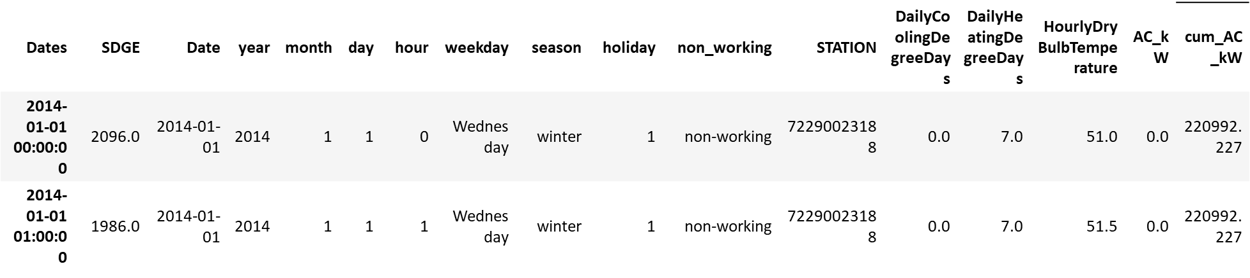
Merging PV with Energy and Weather data
Many NaN values since not all days had solar installations
Since the cumulative installed solar system size should remain same until the next non-NaN value is encountered, using forward fill method to fill the 'cum_AC_kW' column.

Slide 27
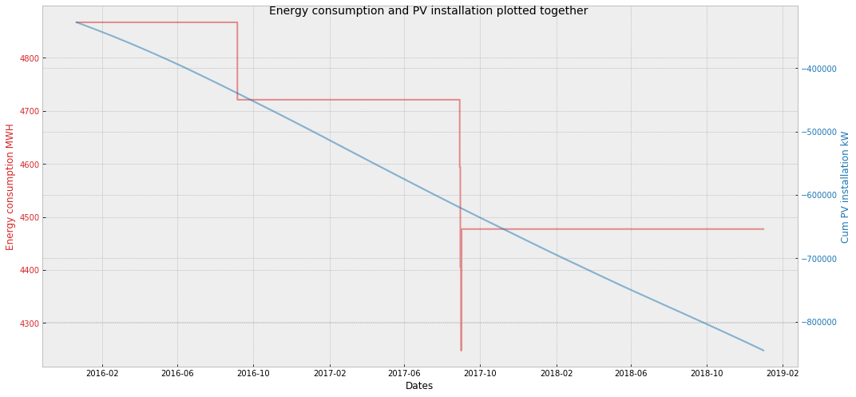
Energy and PV plotted together
Rolling max energy consumption for every 6 months

Slide 28
ML models

Slide 29
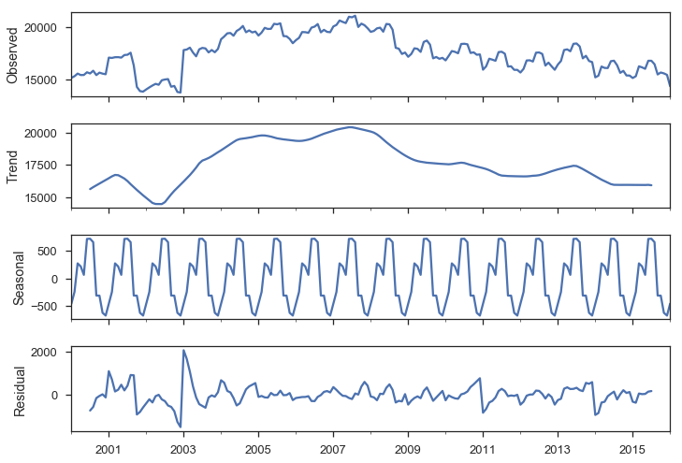
Intro to Time Series (TS)
A sequence of observations taken sequentially in time.
TS components ->
Auto-correlation: observations close together in time tend to be correlated (serially dependent).
Notes:
A sequence of observations taken sequentially in time. Components of TS:
Level: The baseline value for the series if it were a straight line.
Trend: The optional and often linear increasing or decreasing behavior of the series over time.
Seasonality: The optional repeating patterns or cycles of behavior over time.
Noise: The optional variability in the observations that cannot be explained by the model.
Auto-correlation: observations close together in time tend to be correlated (serially dependent). This feature forms an important aspect of the conventional time series modeling techniques like ARIMA.

Slide 30
Forecasting window used
1-hour ahead
1-week ahead
Long term
(1 month to 1 year)

Slide 31
TS Stationarity
For a TS to be stationary it shouldn’t change its statistical properties over time, namely its mean and variance. The covariance function does not depend on time; it should only depend on the distance between observations.
Why is stationarity so important?
- Easy to make predictions since we can assume that the future statistical properties will not be different from those currently observed.
- Most of the time-series models try to predict those properties (mean or variance, for example).
- Future predictions would be wrong if the original series were not stationary.

Slide 32
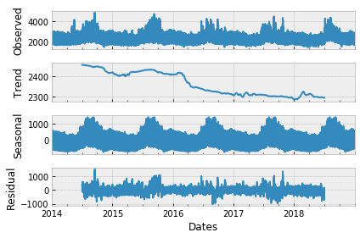
Decomposing SDGE Energy TS
Capturing the yearly seasonality by passing frequency=24*365 to the sm.tsa.seasonal_decompose module of statsmodels.api.
Other observed seasonalities:
Daily (24)
Weekly (24*7)

Slide 33

Testing for Stationarity
Dicky Fuller Test performed on:
1. Original TS -> ts_sdge
2. Differenced once to remove trend-> ts_sdge.diff().dropna()
3. Differenced to remove trend & daily seasonality-> ts_sdge.diff().dropna().diff(24).dropna()
Results of the test:
Weak Stationary
This is maybe because our energy data only has a weak trend. We’ll continue to use the original TS in the ML models.
Medium stationary
Strong Stationary
Results of the test:
Notes:
Based on the p-values of the above tests it seems that even our original dataset is stationary but if we check the t-stat values it is obvious that the stationarity gets more significant with differencing. The original dataset was declared stationary by the test maybe because the trend in our data is very weak (as evident from the decomposed plot). So, we can either use the original dataset as it is with the time series models (as we have done for the linear regression models before), or to be more robust we can use the single differencing to remove the trend and fit our models on the detrended data.

Slide 34
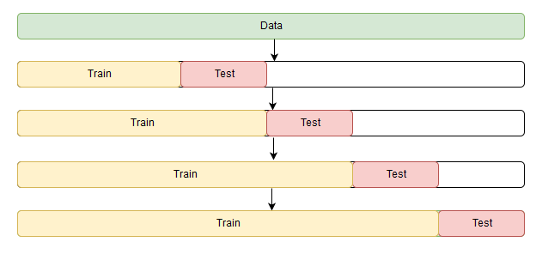
TS Error Metrics & Cross validation (CV)
TSCV
R2 score
MAE (mean absolute error)
RMSE (root mean squared error)
MAPE (mean absolute percentage error)
Notes:
Pic reference:
https://nbviewer.jupyter.org/github/Yorko/mlcourse_open/blob/master/jupyter_english/topic09_time_series/topic9_part1_time_series_python.ipynb

Slide 35
Defining the Baseline
Our time series models will be tested against these baseline models

Slide 36
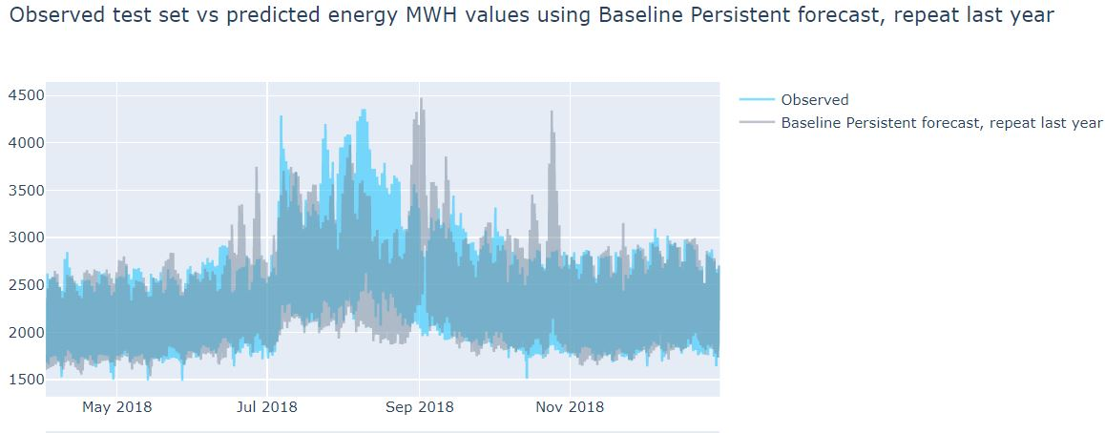
Baseline persistent forecast (long term)
MAPE: 9.23%

Slide 37
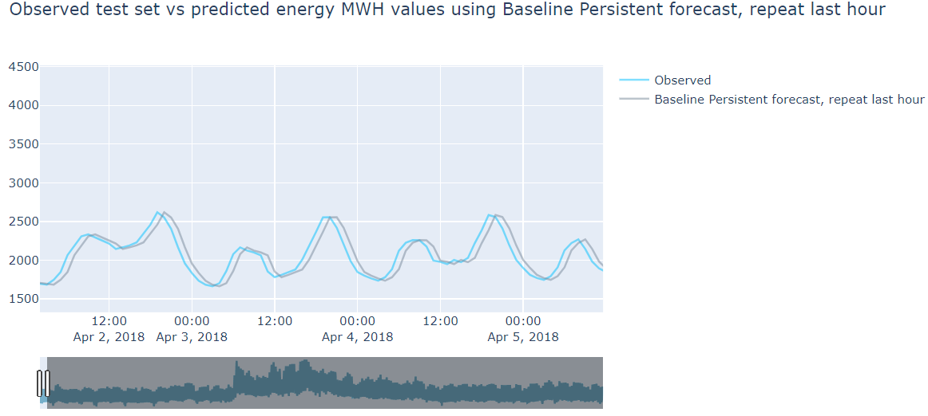
Baseline persistent forecast (hour-ahead)
MAPE: 4.21%

Slide 38
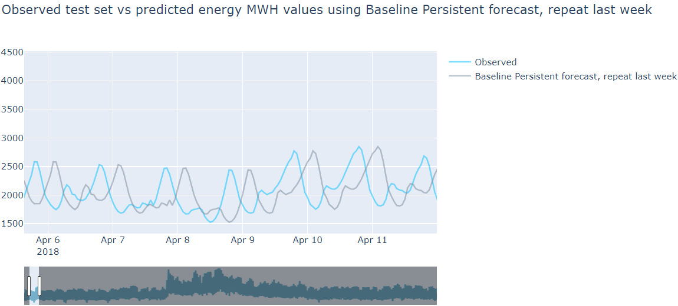
Baseline persistent forecast (week-ahead)
MAPE: 20.27%

Slide 39
Trying Simple linear regression
With L2 regularization (Ridge regression)

Slide 40
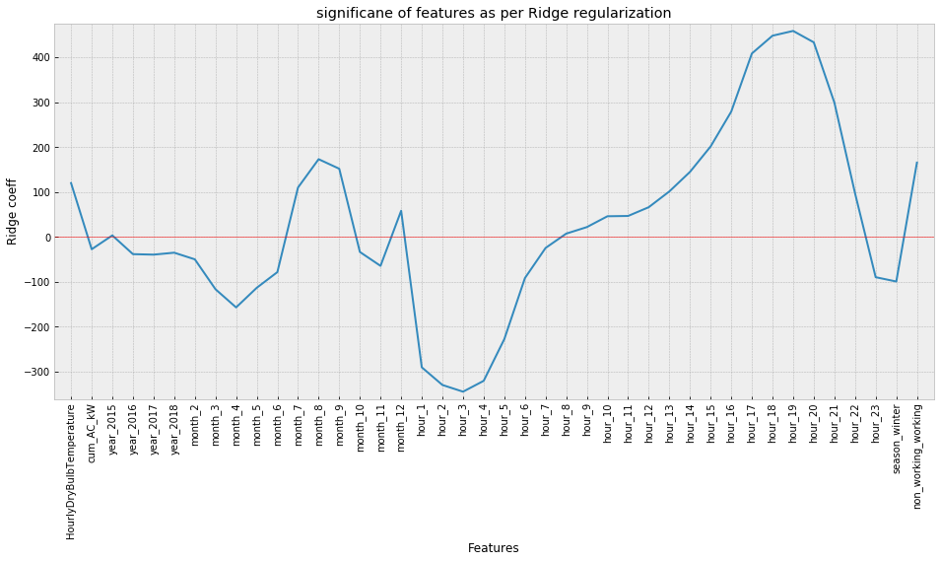
Simple Ridge Linear Regression (long term)
MAPE: 8.18%
Features year, month, hour, season and non_working are categorical
Numerical features have been scaled using Standard Scaler

Slide 41
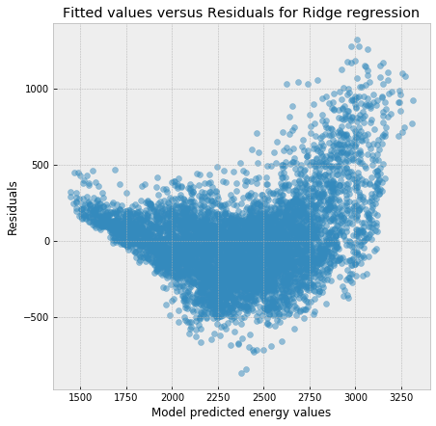
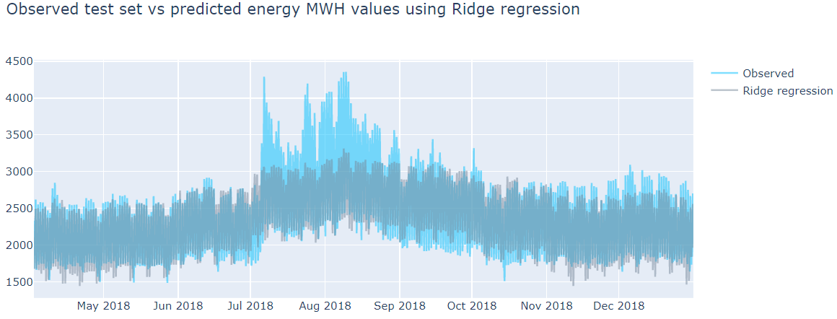
Simple Ridge Linear Regression (long term)

Slide 42
Adding past energy consumption values (up to past 24 hours) known as lags as X variables. i.e. using the auto correlation factor of the time series.
Trying Elastic Net and Random Forest Regression

Slide 43
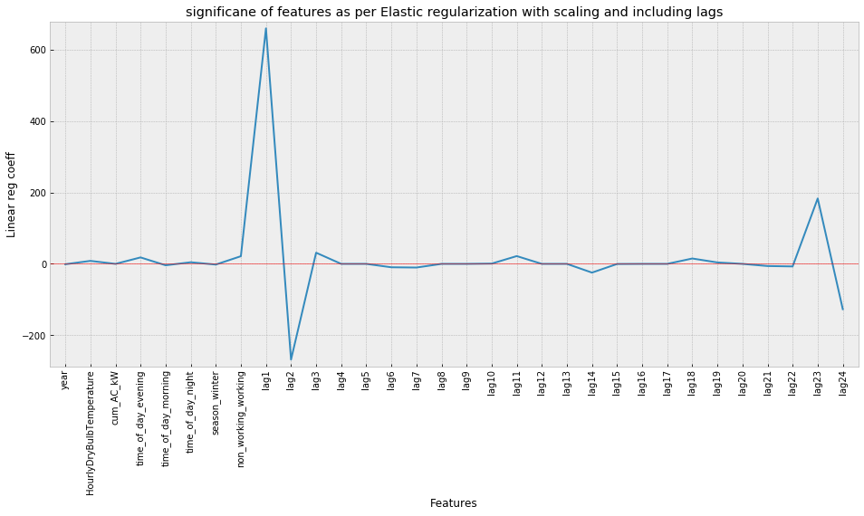
Elastic Net reg with lags (1-hour)
MAPE: 1.58%

Slide 44
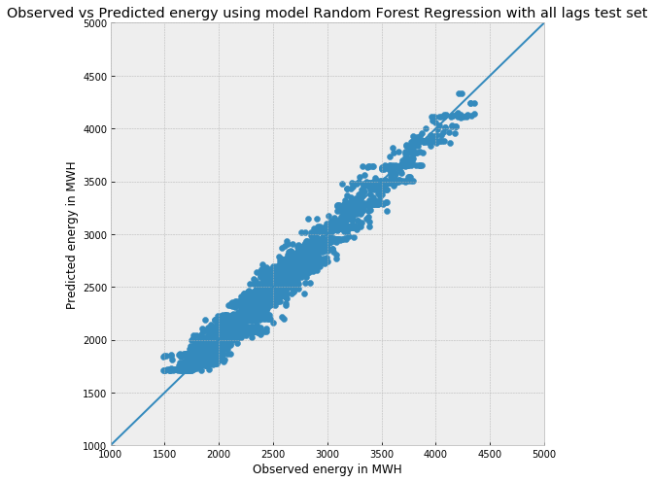
Random Forest with all lags (1-hour)
MAPE: 2.73%

Slide 45
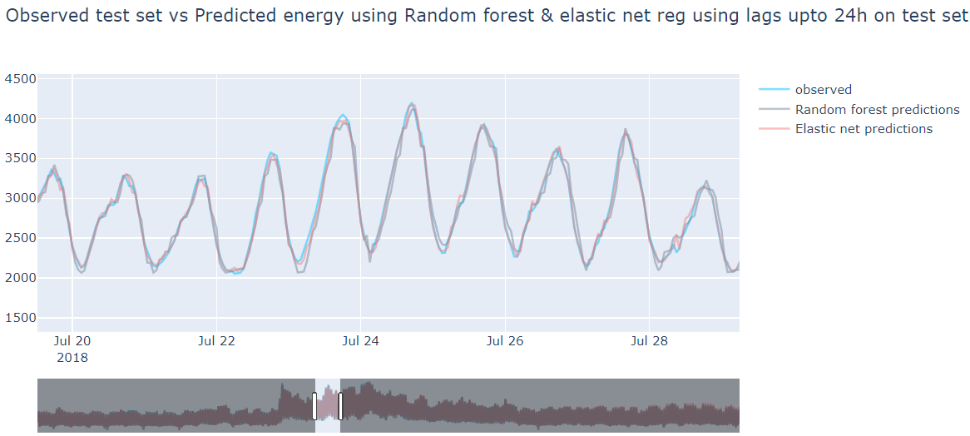
Elastic net and RF with all lags (1-hour)

Slide 46
(S)ARIMA(X) model
Adding Seasonal X terms using Fourier series

Slide 47
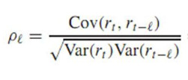
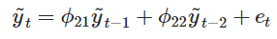
ACF, PACF
Correlation of the time series observations calculated with values of the same series at previous times, is called an autocorrelation (ACF).
It is used to determine the moving average (MA or q) term of the ARIMA(p,d,q) models.
A partial autocorrelation (PACF) is a summary of the relationship between an observation in a time series with observations at prior time steps with the relationships of intervening observations removed.
It is used to determine the auto regression (AR or p) term of the ARIMA(p,d,q) models.

Slide 48
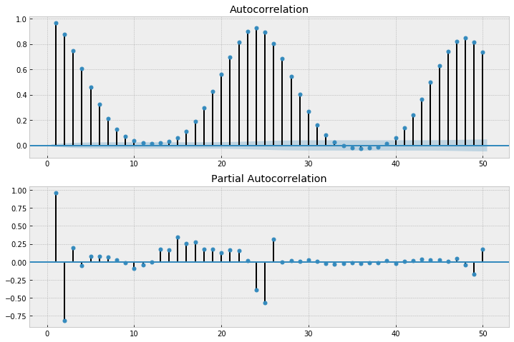
ACF, PACF on Energy TS
On original time series

Slide 49
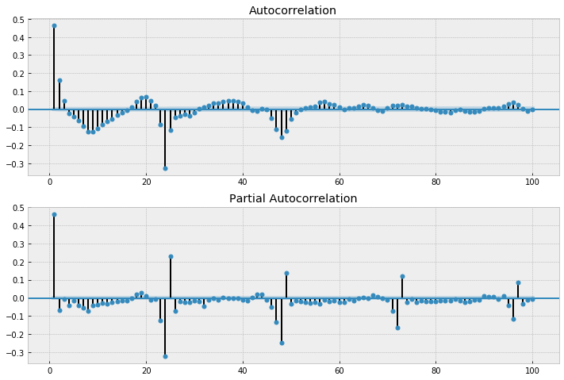
ACF, PACF on Energy TS
On TS_SDGE.diff().dropna().diff(24).dropna() .diff(24*365).dropna()
Removing the trend, daily and yearly seasonalities.
Not very conclusive

Slide 50
(S)ARIMA(X)
ARIMA- Auto Regressive Integrated Moving Average Model
S – Seasonality, X – Exogenous variables like Temperature, PV installations, non_working, etc.
AR – concept of PACF; MA – concept of ACF
But SARIMAX can handle only 1 seasonality and our energy time series has at least 3 evident seasonalities.
We can handle this by creating seasonal X variables using Fourier series which can be passed into the model as exogenous variables.

Slide 51
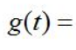
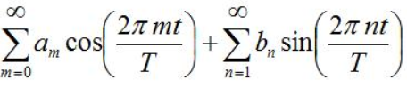
Adding Fourier cyclical series for hour, year and week periods
m & n can be discrete.
Choosing m=n=5 based on some trial and test on the training set
Daily -> T = 24
Yearly -> T = 365.25
Weekly -> 7

Slide 52
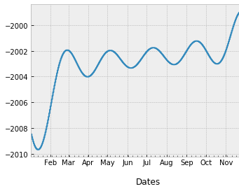
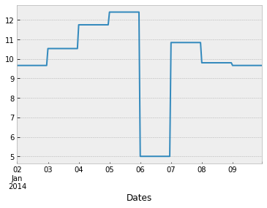
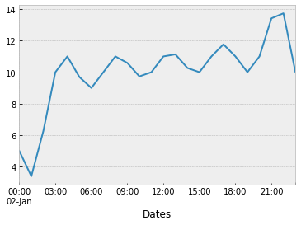
Visualizing the added Fourier seasonal terms
Sum of all yearly Fourier terms
Sum of all weekly Fourier terms
Sum of all daily Fourier terms
We will be adding these new 30 columns (5 sin and 5 cos terms for each season) as our X columns for predictions

Slide 53
SARIMAX (contd.)
Running pm.auto_arima with some parameters for tuning gave out the best model as SARIMAX(2,1,1)x(1,0,1,24).
The auto regressive term p=2 means two values from the past (1 and 2 hours behind) will be used and moving average term of q=1 means 1 past term will be used as the moving average term. d=1 term means the energy series will be differenced once.
Seasonal period m of 24 hours here and P=Q=1 means both the auto regressive term (P) and the moving average (Q) of exactly 1*24 hours behind will be used.

Slide 54
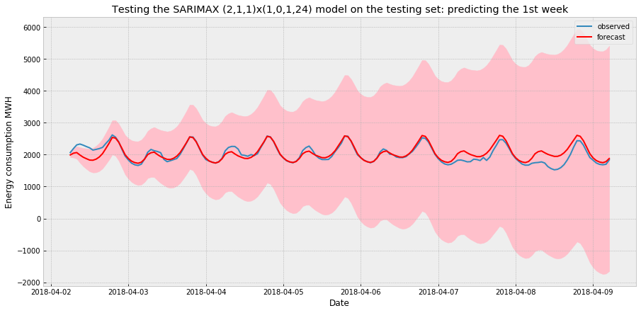
SARIMAX (contd.)
MAPE : 5.33% for 1-week ahead
But model still doesn’t capture the multiple seasonality and predicted terribly bad on more than 1 week windows.
Plus, is very time expensive.

Slide 55
FB Prophet

Slide 56
FB Prophet
Decomposition regression model:
Extendable and configurable with interpretable parameters
Forecasting as a curve fitting exercise rather than time based dependence
Allows to add extra regressor terms (exogenous variables)
𝑦(𝑡)=𝑔(𝑡)+𝑠(𝑡)+ℎ(𝑡)+ϵₜ
𝑔(𝑡) models trend
𝑠(𝑡) models seasonality with Fourier terms
ℎ(𝑡) models the effects of holidays
ϵₜ represents an irreducible error term
Notes:
https://www.digitalocean.com/community/tutorials/a-guide-to-time-series-forecasting-with-prophet-in-python-3
https://dius.com.au/2018/09/04/time-series-forecasting-with-fbprophet/
https://towardsdatascience.com/forecasting-with-prophet-d50bbfe95f91

Slide 57
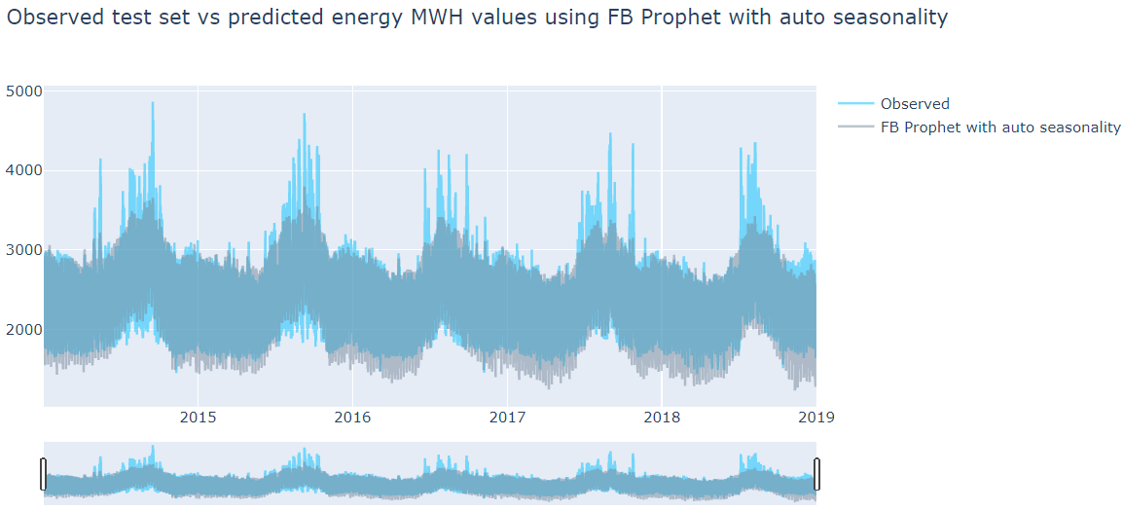
FB Prophet
MAPE : 8.55%

Slide 58
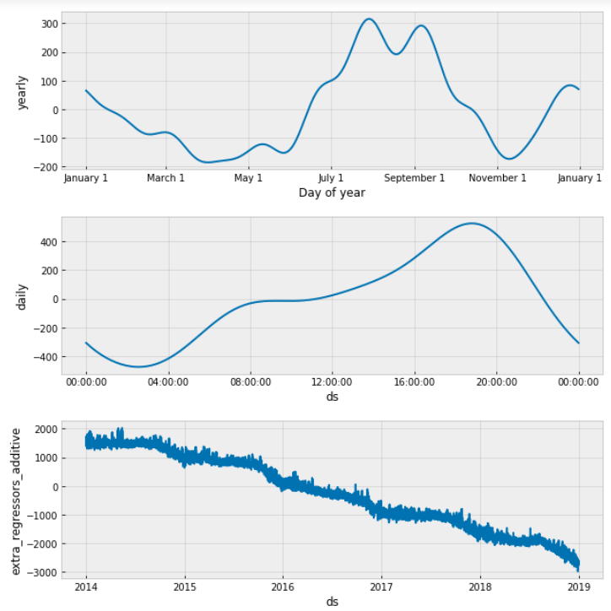
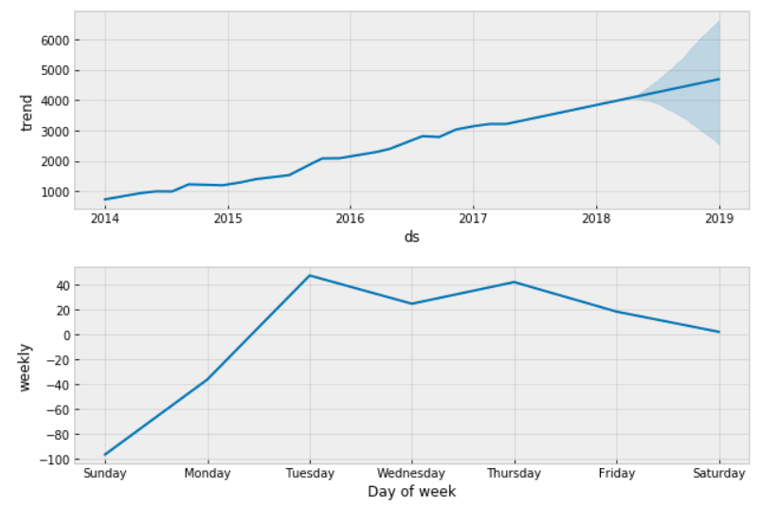
FB Prophet
MAPE is high but the model has learned the underlying structure of our data.
Checking the components of the model

Slide 59
Elastic net, RF and XGBoost using Fourier terms

Slide 60
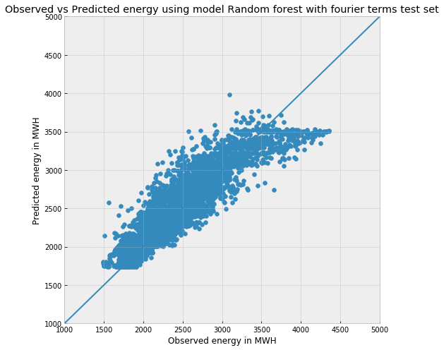
Elastic net and RF using Fourier terms long term
Elastic net MAPE : 8.39%
RF MAPE : 5.73%

Slide 61
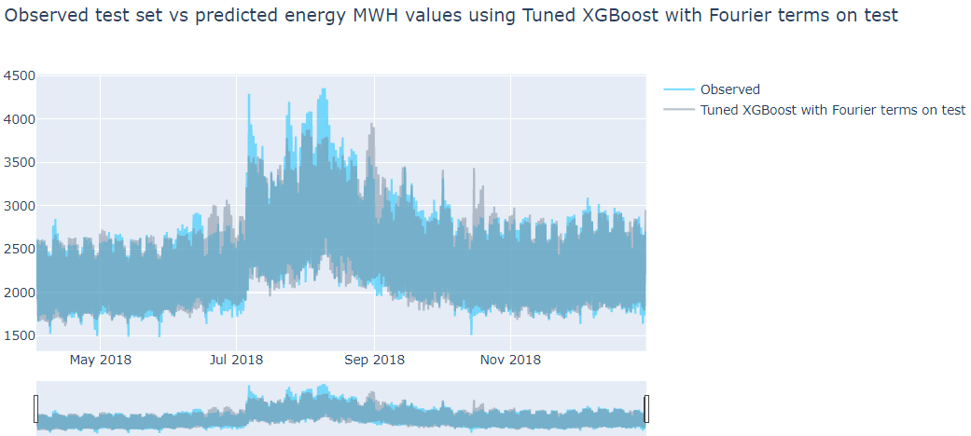
XGBoost with Fourier terms long term
MAPE : 5.08%
Hyperparameters like number of trees, max_depth, etc. were tuned

Slide 62
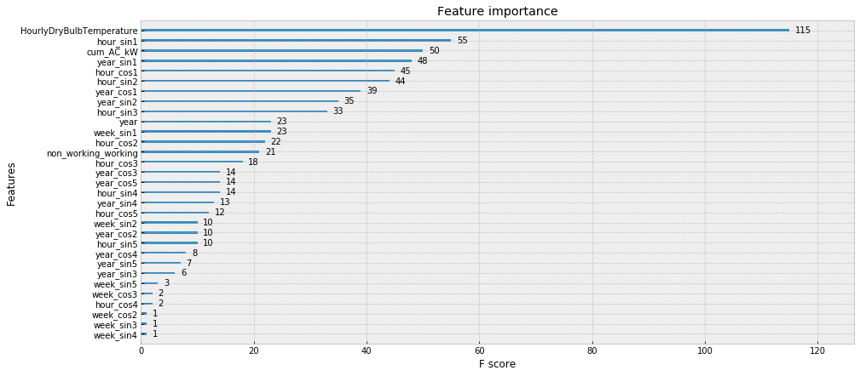
XGBoost with Fourier terms long term
Best results
Entire model tuned and fit under 2 minutes

Slide 63
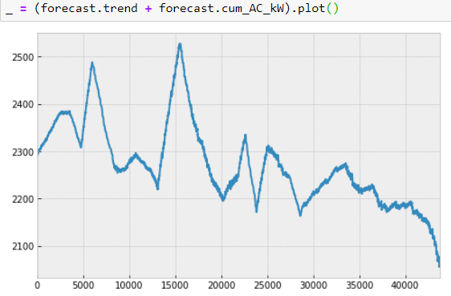
XGBoost + FB Prophet
Our TS had a weak trend but usually the TS is detrended before modeling.
We can detrend the data by removing the main trend & the regressor trend caused by increasing PV installations (since it is a increasing variable the tree models might not catch it well in the test set)

Slide 64
XGBoost + FB Prophet
The clubbed model design (other variations can be tried and tested)
1,4. Original TS with all exogenous variables
2. FB Prophet with all exogenous variables
6. XG Boost with remaining exogenous variables
5. Detrend
4. Only the Trend and PV installations regressor trend
7. Detrended predicted TS
3. Output: Trend, seasonal effects, regressor effect trends
8. Complete predicted TS

Slide 65
XGBoost + FB Prophet
MAPE : 7.3%
Predictions were not better than the XGBoost alone (but better than FB Prophet alone)
Because the combined trend was predicted more negative than actual by the FB Prophet
Need to check if trying different combinations of variable distribution among the two models gives better results. i.e. predicting the impact of Xn variables using 1 model and that of N-Xn variables using other model where N is the total number of X variables being considered.

Slide 66
Conclusion
Note:
Model with “..all lags" and “..1 week“ at end of their names are 1-hour ahead & 1-week ahead forecasts respectively.
All other models have a forecast window of roughly 8 months. And model with "daily max" at end compare the forecasted daily max with the actual daily max. Rest of the models compare hour to hour energy prediction.
NaN values are for the models which couldn't be tested on either the training set or the test set

Slide 67
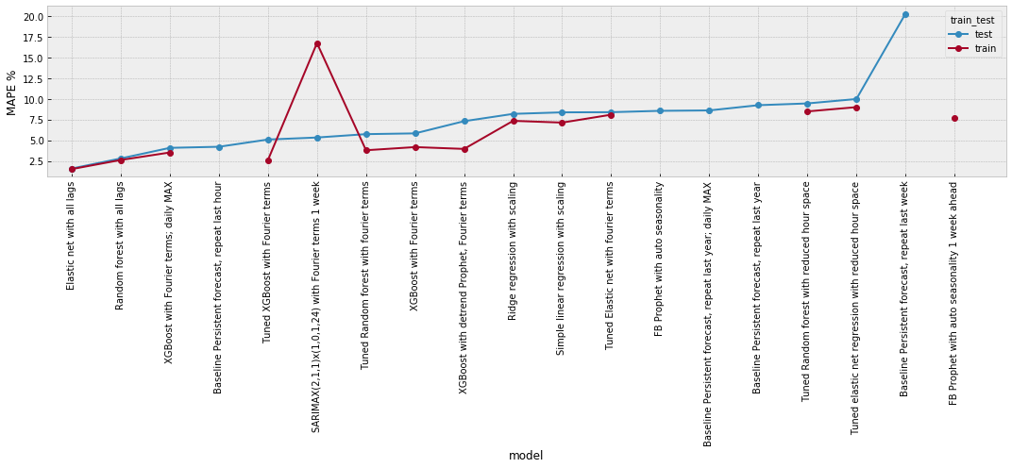
Conclusion
Show the table and plots

Slide 68
Conclusion
Based on the MAPE and other 3 metrics, the XGBoost model with the Fourier terms has performed the best, predicting for a forecasting window of 8 months ahead. MAPE of 5.08% compared to the baseline error of 9.23% on the test set. The difference in RMSE with the baseline model is almost 160 MW which is pretty significant.
For long term forecasts- most of the models have performed better than the baseline persistence model.
FB Prophet does a very good job in identifying the trend and seasonalities of the data for long term. But doesn’t capture the peaks and troughs very well.
For 1-hour ahead forecasts Elastic net or Random Forest with lags up to past 24 hours give better results (1.6~2.8%) compared to baseline (4.2%)
For 1-week ahead too RF or XGBoost with Fourier terms should be used because SARIMAX is very time expensive and didn’t give stable results.

Slide 69
Future work
Bring in the new data of 2019 year and use it as a fresh test set.
Try LSTM and SVR(linear & rbf both)
Check the effect of other variables on energy consumption such as:
The energy storage installation and Electric vehicle (EV) ownership data.
Try some feature engineering by multiplying the PV and energy storage cumulative capacities with the cyclical hour data since their impact on energy consumption of a facility is highly time dependent.
Number of active residential and commercial buildings each month or quarter and overall economic condition of the region also can affect the consumption.
Notes:
A combination of solar panels and batteries usually result in lower dependency of a house or a building on the grid because their combination makes them more self-sufficient. And electric vehicles can add load at different times to the grid, so, battery installation and EV data clubbed with the PV data can help us improve the energy consumption prediction.
- For example, solar panels produce electricity only during the day, so we can help the model understand that the PV impact should be accounted for only during the sunlight hours.

Slide 70

THANKS! Questions? Feel free to reach out to me on Github.
Github repo: link

